Slide 1
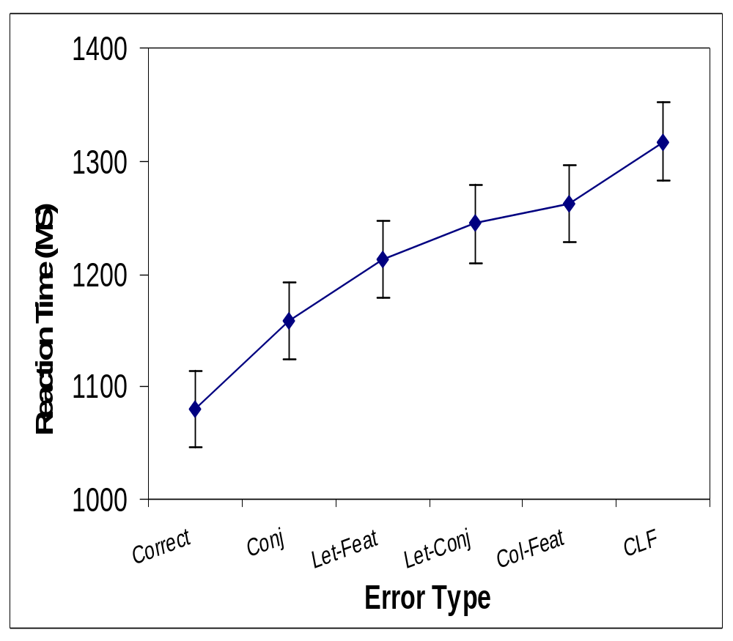

Feature Binding: Not Quite So Pre-attentive
Erin Buchanan and M. Kathryn Bleckley
Texas Tech University
Abstract
Illusory conjunctions occur when perceived features are incorrectly combined to form an object not presented in the visual field. These conjunctions and other aspects of feature binding have long been studied as artifacts of divided attention, distance, similarity, and exposure. Treisman’s (1988) feature integration theory states that these errors in feature combination happen before attention is deployed.
This study was designed to test her theory by examining reaction times for correct vs. 5 types of error responses. Eighty-seven participants were used in a replication of Prinzmetal, Henderson, and Ivry’s (1995) short exposure non-attention-diverting task. Reaction times for correct answers were significantly faster than illusory conjunctions, and other all types of errors, which, contrary to our hypothesis, suggests that preattentive processing may not be faster than deployment of visual attention or may not be ‘pre’ attentive at all.
Results
All reaction times for correct responses and error responses were significantly different from each other
Correct responses were the fastest, followed by conjunctions, letter feature errors, letter conjunctions, color features, and color letter feature errors
Proportions of errors were spread differently than expected, much lower % correct than previous study
To explain these results, an interactive activation computer model (McClelland & Rumelhart, 1981) was programmed
Error Types
Correct – T
Conjunction – T
Letter Feature Error – L
Letter Conjunction Error – L
Color Feature Error – T
Color Letter Conjunction Error – L
OTOO
|
⁻⁻⁻
Feature Level
|
_
/
\
Color Detection
Hypotheses
Reaction times for correct responses should be different from other error types, since attention is required to correctly bind features.
Error rates should be comparable to previously found research.
R
G
B
T
L
X
Results
Reaction times for each error type (natural log transformed).
Proportions of correct and error rates.
Methods
Participants
87 undergraduates at Texas Tech University
Reported normal vision
Apparatus
Replication of Prinzmetal et al (1995), Experiment 3
15-in CRT (60mHz) monitor controlled by an IBM (Pentium 3) computer
Stimuli were uppercase 36 pt. Helvetica font
T
T
T
L
L
L
X
X
X
Response Level
Legend:
Excitatory
Inhibitory
The Model – Inhibitory connections excluded for clearness
Weights for Model Connections
Probabilities from the Data Set and Predicted from Model
_x0016_
Connection Type
Excitatory
Inhibitory
Error Type
Data Set
Model Prediction
_x0003_
Feature to Feature
0.011
-0.11
Correct
.350
.382
OTOO
Conjunction
.162
.159
7.2º
Letter to Letter
0.011
-0.19
Letter Feature
.233
.108
Color to Color
0.001
-0.002
Letter Conjunction
.168
.116
Output to Output
0.001
-0.02
Color Feature
.040
.116
5.7º
Color Letter Feature
.046
.120
Discussion
Assessment of Feature Integration Theory’s claims of pre-attentive processing and feature binding showed that attention is not only used for correctly combining objects. These findings are contrary to current ideas (Treisman, 1988; Ashby et al, 1996; Prinzmetal et al, 1995) of feature binding in the literature. Reaction times for correct answers and error answers show that errors are slower than correct answers, which follows with a general understanding that negative things take longer to process. Here, incorrect answers can be slower due to incomplete information, slower parsing of location information, or a general hesitation to guess at an answer.
Modeling of this problem has also proved fruitful, helping to explain how the current set of correct and error type probabilities can be produced. A general reproduction of reaction times produced in this experiment was also found with the model. Inhibitions on the feature and letter connection levels seem to be driving the production of correct and error response rates.
7.6º
8.2º
0.4
0.35
Example of display with visual angles
0.3
Targets were always colored X, L, or Ts
Colors presented were always red, green, or blue
Target presented by colored distractor O
2 white flanking Os always present
Responses made orally
Display time was 150ms
Procedure
Calibration trials
6 blocks of target naming
0.25
0.2
Proportion
0.15
References
Ashby, F., Prinzmetal, W., Ivry, R., & Maddox, W. (1996). A formal theory of feature
binding in object perception. Psychological Review 103(1), 165-192.
McClelland, J. L. & Rumelhart, D.E. (1981) An interactive activation model of context
effects in letter perception: I. An account of basic findings. Psychological Review
88(5), 375-407.
Prinzmetal, W., Henderson, D., & Ivry, R. (1995). Loosening the constraints on illusory
conjunctions: assessing the roles of exposure duration and attention. Journal of
Experimental Psychology: Human Perception and Performance 21(6), 1362-
1375.
Treisman, A. (1988). Features and objects: the fourteenth Bartlett memorial lecture. The
Quarterly Journal of Experimental Psychology 40A(2), 201-237.
Treisman, A. & Gelade, G. (1980). A feature-integration theory of attention. Cognitive
Psychology 12, 97-136.
Treisman, A. & Schmidt, H. (1982). Illusory conjunctions in the perception of objects.
Cognitive Psychology 14, 107-141.
0.1
0.05
0
correct
let-feat
let-conj
conj
col-let
clf
Error Type

